Slide 1
Economic transformations in the 1970s

Slide 2
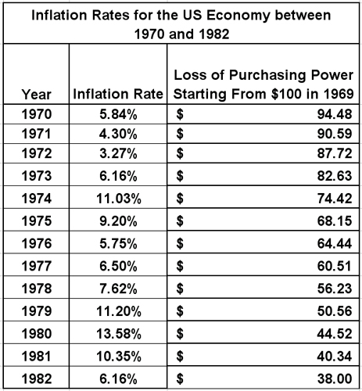
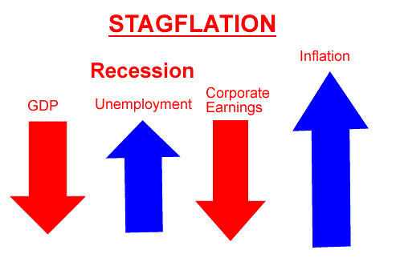
Stagflation
Combination of unemployment and inflation
prices rose in a stagnant economy

Slide 3
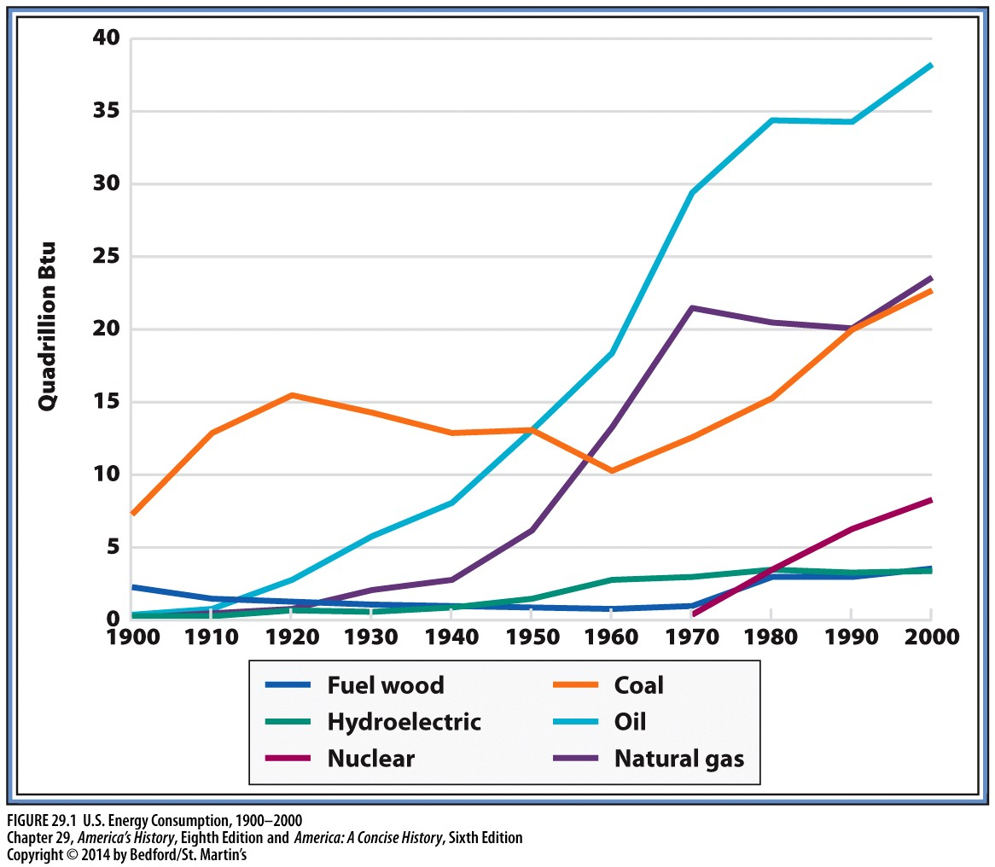
U.S. Energy Consumption 1900-2000

Slide 4
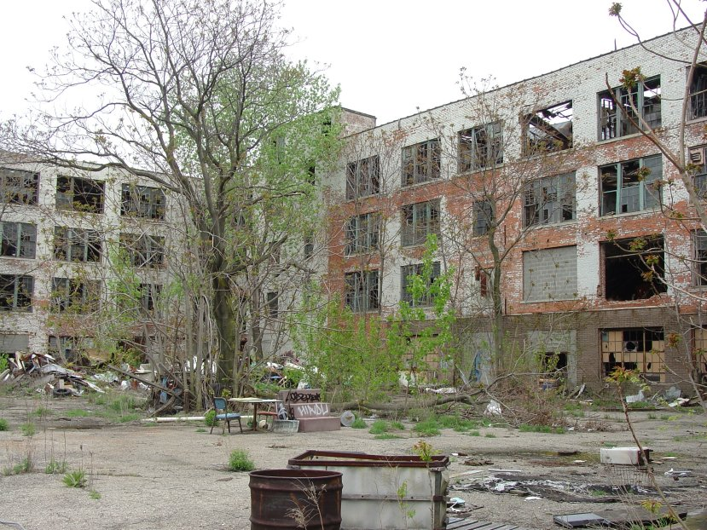
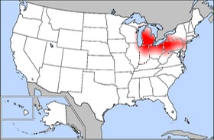
Deindustrialization
America’s industrial sector weakened
steel industry was hardest hit by competition from West Germany and Japan
Rust Belt

Slide 5
Tax revolt and economic inequality
Tax revolt: dramatic reversal of the postwar spirit of generous public investment
real estate prices and property tax rates increased dramatically
in California, the “Proposition 13” initiative rolled back property taxes, capped future increases, and required a two-thirds majority for all tax measures in the state legislature.

Slide 6
OPEC OIL EMBARGO OF 1973
On October 17, 1973, Arab oil producers declared an embargo that drastically limited the shipment of oil to the United States

Slide 7
Why an Embargo?
On October 6, 1973, Egypt and Syria launched a military offensive against Israel in a conflict that came to be known as the Yom Kippur War, after the Jewish holy day that marked the conflicts first day
The U.S. gave aid to Israel in this war
Then, the 7 Arab nations in the OPEC (Organization of Petroleum Exporting Countries) declared an oil embargo on the U.S.

Slide 8
Immediate Impact
Prior to the embargo, the U.S. was heavily dependent on Middle Eastern oil for energy
Following the embargo, daily shipments of oil from the Middle East dropped from 1.2 million barrels to a scant 19,000 barrels
A panic erupted within the U.S., as citizens thought this could be karma for their exploitation of Middle Eastern oil and ultimately lead to the destruction of their society

Slide 9
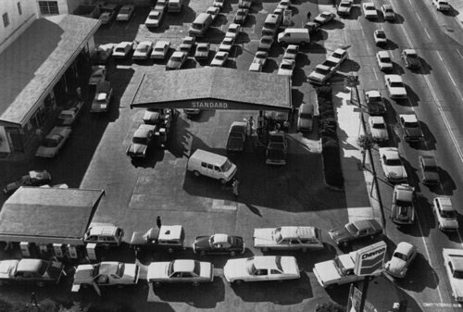
Immediate Impact (cont.)
As a result of the limit on oil, lines at gas stations grew tremendously.

Slide 10
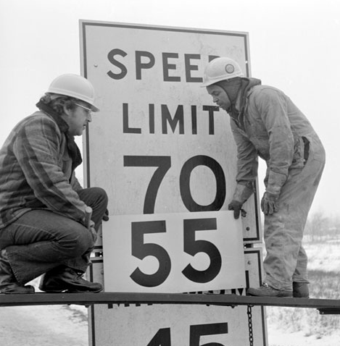
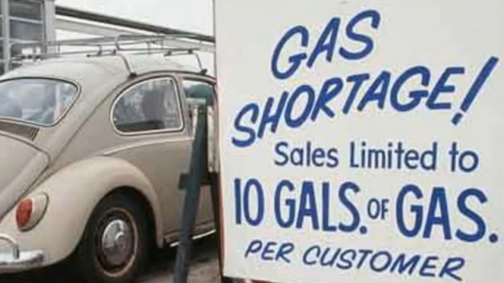
Gas Stations

Slide 11
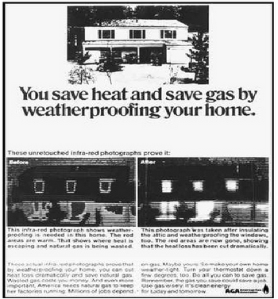
Significance
The energy crisis led to a fundamental reevaluation of the typical American’s lifestyle.

Slide 12
Significance (cont.)
In cities and suburbs throughout America, fuel efficiency and conservation of energy were emphasized
The energy crisis also contributed to a new awareness of the environmental impact of America’s past energy consumption
In conclusion, as a result of the OPEC Oil Embargo of 1973, citizens and government officials were made aware of their impacts on the environment and the economy in their efforts towards expansion and industrialization for energy

Slide 13
Environmentalism
Congress passed the National Environmental Policy Act (1970), which created the EPA
Clean Air Act (1970)
Occupational Health and Safety Act (1970)
Water Pollution Control Act (1972)
Endangered Species Act (1973)
Corporations and workers vs. Environmentalists

Slide 14
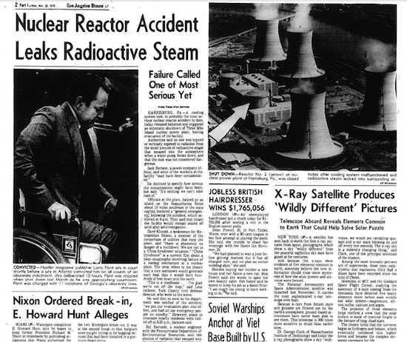
Nuclear Power
Initially viewed as an alternative to coal and/or oil
environmentalists cautioned the catastrophic ramifications of a meltdown, including radioactive wastes
meltdown at Three Mile Island (Harrisburg, PA, March 1979) led to 100,000 people fleeing their homes.

